Slide 1

The Spring Framework
Tom Cools| 16 march 2017 | ISBE Mechelen

Slide 2

Tom Cools
tom.cools@infosupport.com
@TCoolsIT
Consultant
“We do what we must, because, we can…”

Slide 3


Slide 4


Slide 5
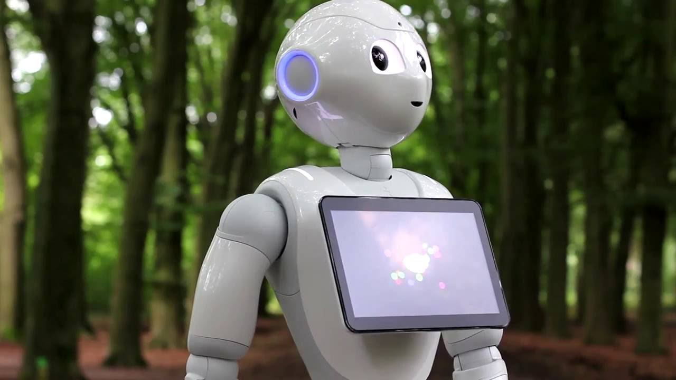
Notes:
HOUSE RULES

Slide 6

Professional Java Development

Slide 7




Web/Application Servers

Slide 8
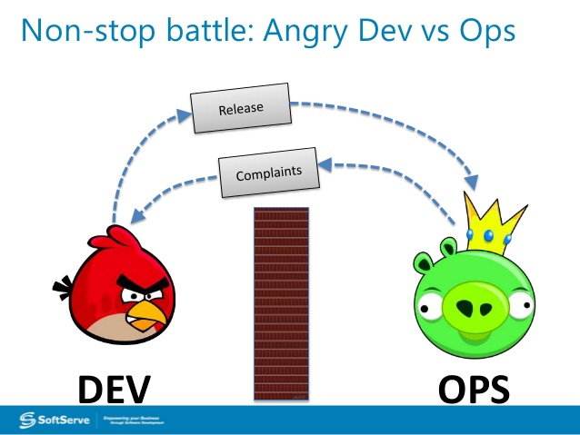


Slide 9

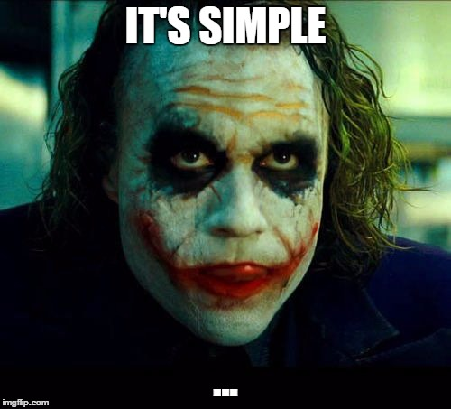
“Application Servers are dead” – Eberhard Wolff
Notes:
http://www.slideshare.net/ewolff/java-application-servers-are-dead

Slide 10


Slide 11







Instead we use:
Notes:
http://modules.dropwizard.io/

Slide 12


Slide 13
What is Spring?
Java Platform
Open-Source
Beta Release: 2002
Current Version: 4.3
Great Community!

Slide 14


Slide 15
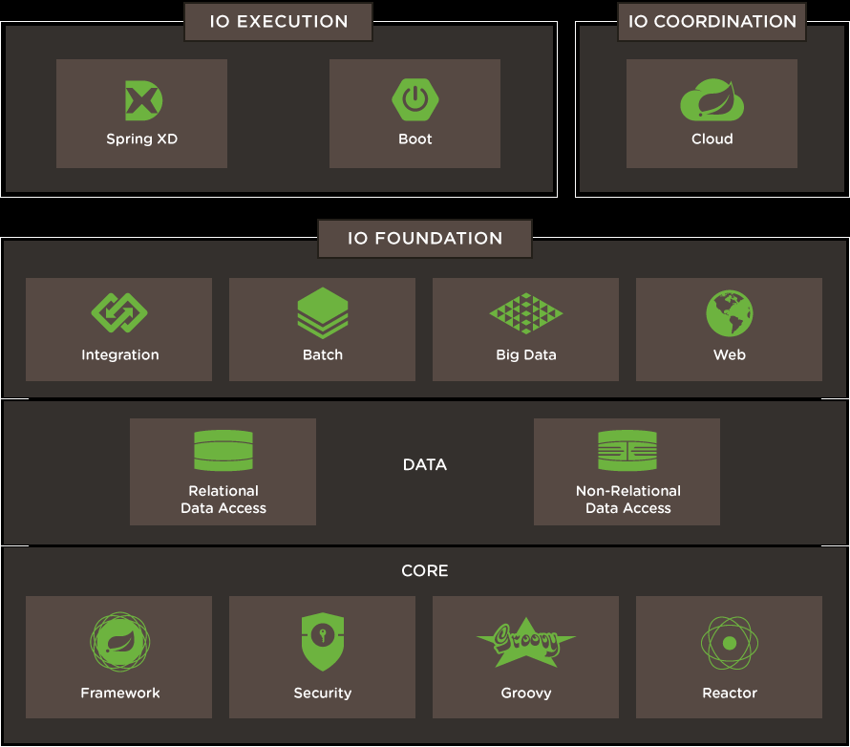

Slide 16
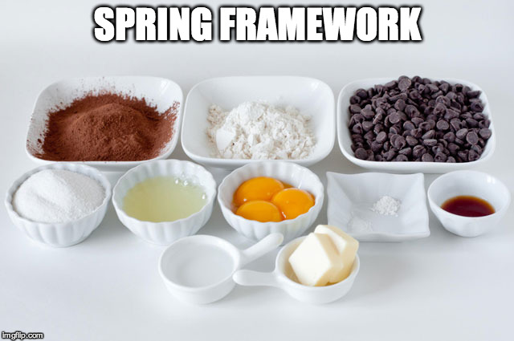

Slide 17
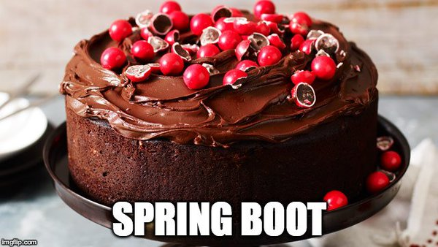

Slide 18

What is Spring Boot?
Stand-alone Spring Application
Pre-configured
Production Ready
Metrics
Health Checks
Configuration

Slide 19
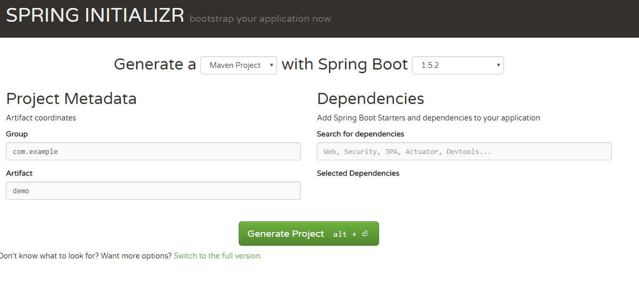
Starter.Spring.IO

Slide 20
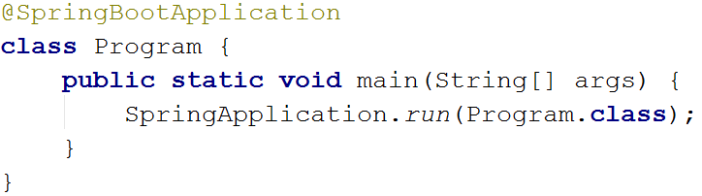
Minimal Application

Slide 21
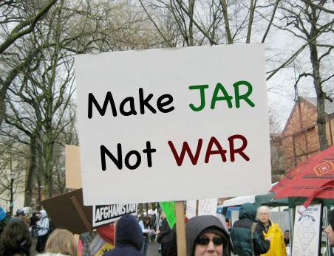

Slide 22


Slide 23

A “simple“ servlet implementation
public void doGet(HttpServletRequest request,
HttpServletResponse response)
throws ServletException, IOException {
//Parse the product id
int index = request.getRequestURL().lastIndexOf("/");
String idString = request.getRequestURL()
.substring(index + 1);
//Create XML representation
//…
//Setup the response
response.setContentType("application/xml");
response.getWriter().write(productXML);
response.setStatus(HttpServletResponse.SC_OK);
}

Slide 24

Demo
Notes:
Monolithic and no implementations

Slide 25
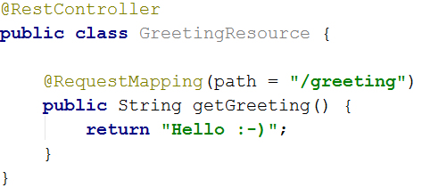
Example resource

Slide 26
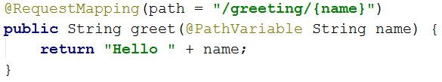
Path Parameters
http://{{server}}/greeting/Tom

Slide 27
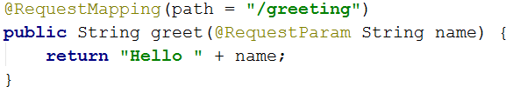
Query Parameters / Request Parameters
http://{{server}}/greeting?name=Tom

Slide 28
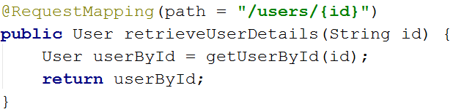
Working with Objects
“User” is a Plain Old Java Object (POJO) Result is JSON by default: {"firstName":"Tom","lastName":"Cools"}

Slide 29
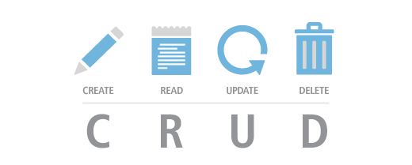

Slide 30
CRUD API Design

Slide 31
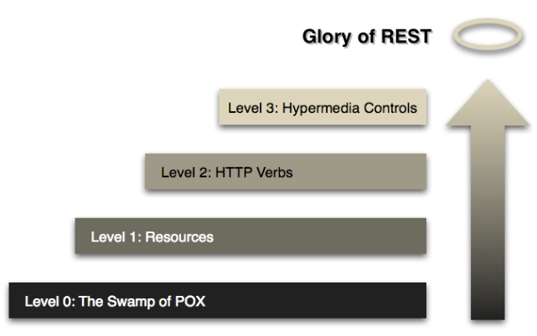

Slide 32
Common HTTP Method usage
Method | Description
GET | Retrieve a resource representation
PUT | Add or modify a resource with a specified URI
DELETE | Delete a resource
HEAD | GET without body: “Does this resource exists?”
POST | Overloaded: implementation may vary. Might generate a new URI

Slide 33
Demo
Notes:
Monolithic and no implementations

Slide 34
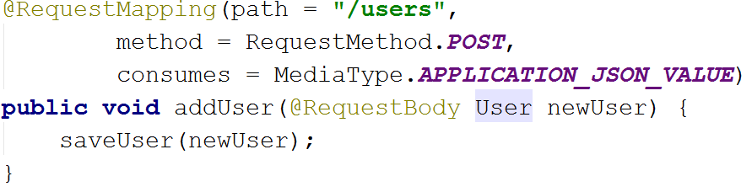
@RequestMapping
Method: HTTP Method (GET/POST/PUT/DELETE/..)
Consumes: Incoming Media Type
Produces: Outgoing Media Type (JSON by default)
@RequestBody: Get the body of the request

Slide 35
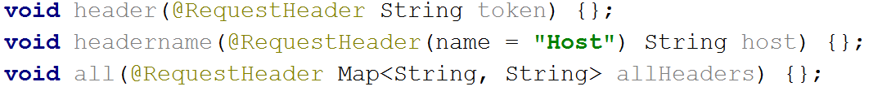
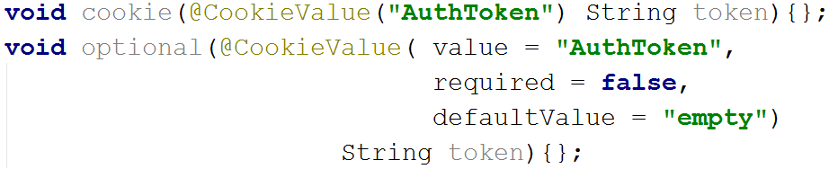
Accessing Headers
Accessing Cookies

Slide 36
Calling other API’s
AKA: Let them do the hard work…
Notes:
http://api.fixer.io/latest

Slide 37
Demo

Slide 38
Calling another API
RestTemplate
Easy to call other endpoints
Automatic conversion into Java Objects
Highly configurable

Slide 39
Example
RestTemplate
RestTemplate restTemplate = new RestTemplate();
Quote quote = restTemplate.getForObject(
"http://quotemaker/api/random", Quote.class);

Slide 40
API
Big API available for basically any request
API
https://docs.spring.io/spring/docs/current/javadoc-api/org/springframework/web/client/RestTemplate.html
Notes:
https://docs.spring.io/spring/docs/current/javadoc-api/org/springframework/web/client/RestTemplate.html

Slide 41
Inversion of Control – Dependency Injection

Slide 42
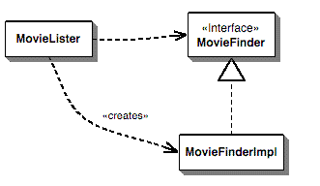
Without Dependency Injection
MovieListener Depends on Interface
Impl implements interface
MovieListener creates the Impl
MovieListener knows too much
Hard to test MovieListener
Hard to change out the implementation for another one…
Notes:
http://projects.spring.io/spring-data/#quick-start

Slide 43
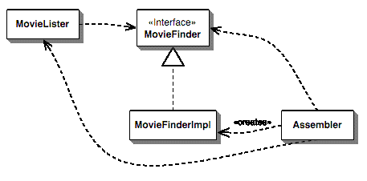
With Dependency Injection
MovieListener Depends on Interface
Impl implements interface
MovieListener asks Assembler to give him the Implementation
Assembler creates Impl
MovieListener know only about the interface ☺
Changing Implementation is Easy, only Assembler changes ☺
Notes:
http://projects.spring.io/spring-data/#quick-start

Slide 44

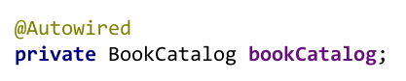

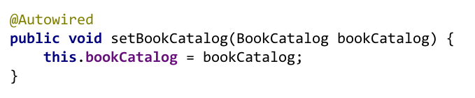

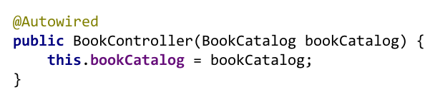
@Autowired – Automatic Dependency Injection
Field injection
Setter injection
Constructor injection

Slide 45
The Magic Annotation
@SpringBootApplication
@Configuration
@EnableAutoConfiguration
@ComponentScan

Slide 46

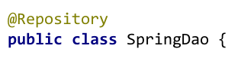



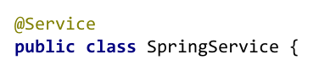

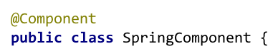


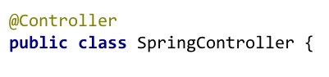
Defining Spring Beans With Class Annotations
Notes:
| @Component | generic stereotype for any Spring-managed component |
| @Repository| stereotype for persistence layer |
| @Service | stereotype for service layer |
| @Controller| stereotype for presentation layer (spring-mvc) |

Slide 47
Manual Bean Creation
Add @Bean on any method
And voila! It’s a Bean.
@Bean
public RestTemplate createTemplate() {
return new RestTemplate();
}
Notes:
https://docs.spring.io/spring/docs/current/javadoc-api/org/springframework/web/client/RestTemplate.html

Slide 48

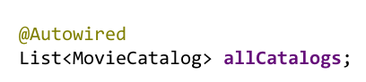

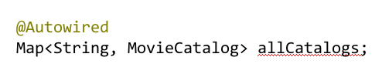
Injecting multiple implementations

Slide 49
Injecting our Dependencies
Decouple Object from it’s dependencies
Pushes you towards programming against Interfaces
Makes your code easier to test
Avoid creating your own dependencies!
Notes:
https://martinfowler.com/articles/injection.html#InversionOfControl

Slide 50
Accessing the Database

Slide 51
A Typical JDBC Query example
public static void main (String[] args) {
try {
String url = "jdbc:msql://200.210.220.1:1114/Demo";
Connection conn = DriverManager.getConnection(url,"","");
Statement stmt = conn.createStatement();
ResultSet rs;
rs = stmt.executeQuery("SELECT Lname FROM Customers WHERE Snum = 2001");
while ( rs.next() ) {
String lastName = rs.getString("Lname");
System.out.println(lastName);
}
conn.close();
} catch (Exception e) {
System.err.println("Got an exception! ");
System.err.println(e.getMessage());
}
}

Slide 52

JPA Style

Slide 53


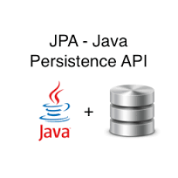
Spring Data
“Spring Data’s mission is to provide a familiar and consistent, Spring-based programming model for data access while still retaining the special traits of the underlying data store. “
Notes:
http://projects.spring.io/spring-data/#quick-start

Slide 54
Demo
Notes:
Monolithic and no implementations

Slide 55
Default Interfaces
CRUDRepository: Automatically implements CRUD actions
Save/Delete/Count/Exists/…
PagingAndSortingRepository:
Everything CRUDRepository has
Paging and Sorting options
Page<User> users = repository.findAll(new PageRequest(1, 20));
Notes:
http://projects.spring.io/spring-data/#quick-start

Slide 56
Auto-Implemented Interface Methods
List<User> findByLastName(@Param(“q") String lastname);
List<User> findByLastNameIgnoreCase(@Param(“q") String lastname);
List<User> findByLastNameAndFirstName(
@Param(“last") String lastname, @Param(“first") String firstname);
List<User> findByLastNameOrderByLastNameDesc(
@Param(“last") String lastname, @Param(“first") String firstname);
Notes:
http://projects.spring.io/spring-data/#quick-start

Slide 57
Supported Keywords
Keyword Type | Keywords
Combinations | And, Or
Exact Equality | Is, Equals, IsNull, IsNotNull, True, False
Numeric Selection | Between, LessThan, LessThanEqual, GreaterThan, GreaterThanEqual
Date Selection | After, Before
String Selection | Like, NotLike, StartingWith, EndingWith
Range Selection | In, NotIn

Slide 58
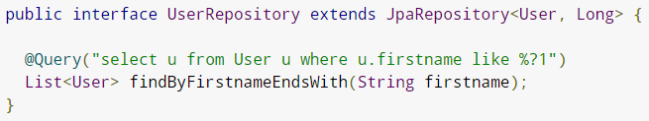
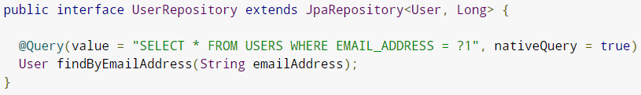
JpaRepository extends CrudRepository

Slide 59
Validation API

Slide 60
Demo
Notes:
Monolithic and no implementations

Slide 61
Adding Validation
RequestMapping(“/idea”)
public Idea add(@Validated Idea idea) {}
public class Idea {
@NotNull
@Size(min = 1, max = 30)
private String title;
@Past
private Date origin;
}
Notes:
http://projects.spring.io/spring-data/#quick-start

Slide 62
Bean validation API
API
http://docs.oracle.com/javaee/7/api/javax/validation/constraints/package-summary.html
Custom validation is possible, but out of scope for this presentation
Notes:
https://docs.spring.io/spring/docs/current/javadoc-api/org/springframework/web/client/RestTemplate.html

Slide 63
Conclusion

Slide 64
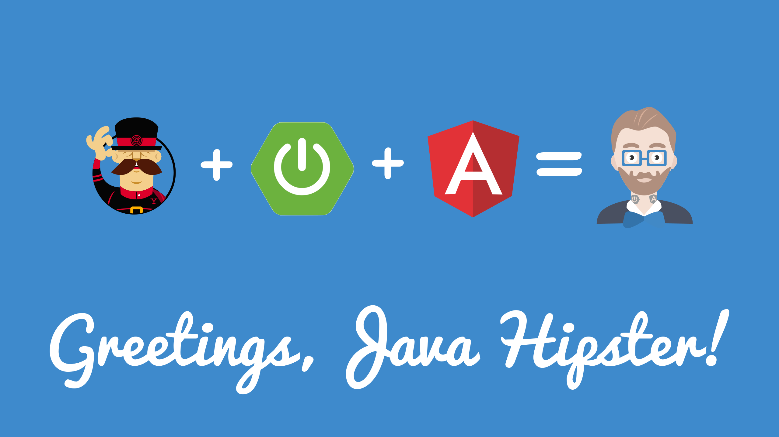

Slide 65

The Exercise! ☺

Slide 67
What went wrong during the demo?
Cyclic dependency

Slide 68
The Error
***************************
APPLICATION FAILED TO START
***************************
Description:
The dependencies of some of the beans in the application context form a cycle:
imageResource (field com.infosupport.ap.exercise.services.CognitiveServices com.infosupport.ap.exercise.resources.ImageResource.faceAPI)
┌─────┐
| cognitiveServices defined in file [C:\repos\spring-boot-ap-exercise\target\classes\com\infosupport\ap\exercise\services\CognitiveServices.class]
└─────┘

Slide 69
The Reason
@Autowired
public CognitiveServices(RestTemplate restTemplate) {
this.restTemplate = restTemplate;
}
@Bean
public RestTemplate createTemplate() {
return new RestTemplate();
}
You can’t @Autowire a Bean into a constructor if that Bean is declared in the same class.
Because Spring can’t create the class without the RestTemplate, the method doesn’t exist and because of that, there is no @Bean RestTemplate for Spring to use
Notes:
https://docs.spring.io/spring/docs/current/javadoc-api/org/springframework/web/client/RestTemplate.html

Slide 70
Possible Solution 1 - @Autowire on Field
@Autowired
RestTemplate
@Bean
public RestTemplate createTemplate() {
return new RestTemplate();
}

Slide 71
Possible Solution 2 – @Bean in another class.
By putting the code below in a different class, the RestTemplate does exist when the constructor (@Autowired) is called.
@Bean
public RestTemplate createTemplate() {
return new RestTemplate();
}

